Slide 1


Data WH Mining Term Project
Team 6:
Benjamin Huus
Raja Yeswanth Nalamati
Sreenilaya Cherukumalli
Notes:
Hello everyone, my name is Benjamin Huus, and today our team will be going over our Data Warehouse and mining term project

Slide 2

Data Warehousing using Star/Snowflake Schemas
Star Schema
Star Schema Advantages/Disadvantages
Star Schema Example
Snowflake Schema
Snowflake Schema Advantages/Disadvantages
Snowflake Schema Example
Star Implementation
Snowflake Implementation
Conclusion
Notes:
For this project, we chose to discuss the differences of data warehousing using star and snowflake schemas. On this slide you can see a list of topics we will cover.

Slide 3

Star Schema
Database Schema
Fact table
Dimension tables
OLAP optimization
Denormalized
Notes:
A star schema is a type of database schema that is optimized for data warehousing and online analytical processing (OLAP) applications. It is called a start schema because its structure resembles that of a star, with a central fact table connected to several dimensional tables. The star schema is designed to simplify querying and improve the performance of complex queries by organizing data in a way that makes it easy to understand and navigate.
The fact table is the central table in the star schema. It contains data related to the business process being evaluated. Each row in the fact table typically represents a unique event or transaction. Common attributes in the fact table include numeric values such as sales amount, quantity sold, and revenue. The table also contains foreign keys that reference primary keys in the dimension tables, establishing relationships between the fact table and the dimension tables.
Dimension tables surround the fact table and provide descriptive context to the facts. Each dimension table contains attributes that describe aspects of the business process, such as time, product, customer, or geography. Dimension tables are traditionally denormalized, meaning they store redundant data to make it easier and faster to perform queries. Each dimension table has a primary key that uniquely identifies each row, and these primary keys are used as foreign keys in the fact table.

Slide 4

Star Schema Advantages/Disadvantages
Denormalization
Fewer Table Joins
Easily understood
Optimized for OLAP
Notes:
There are many reasons why star schemas are effective for data warehousing. A star schema is fast for querying primarily due to its simplified structure, which is designed to optimize data retrieval and improve query performance. One key reason for the improved query performance is that the dimension tables are typically denormalized. This means that they store redundant data to minimize the number of joins required during queries. This reduces the complexity of queries and improves performance. Denormalized tables allow for fewer tables to be joined, which reduces the time needed to execute queries. A star schema is also a very straight forward data model. With a central fact table and surrounding dimension tables, this makes it easy for users to understand and navigate. However, there is a lower storage efficiency due to data redundancy.
There are clear relationships between the fact table and the dimension tables to simplify query construction, which leads to faster and more efficient query processing.
Star schemas are optimized to work for Online Analytical Processing (OLAP), which involves complex queries that aggregate and analyze large amounts of data. The schema’s structure supports efficient aggregation and summarization, which are common operations in OLAP queries.
Overall, the star schema’s design principles and optimization techniques contribute to its efficiency and speed in querying large datasets in data warehousing environments at the cost of additional storage requirements and complicated row inputs.

Slide 5
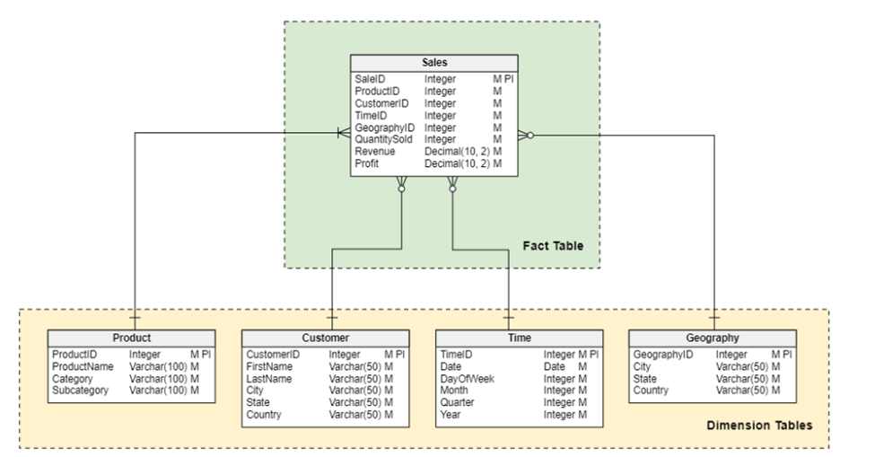
Star Schema Example
Notes:
In this example, each sales transaction is stored within the Sales table, which is being used as the fact table. You can see various foreign keys within the Sales table such as ProductID, CustomerID, TimeID, and GeographyID which are used to connect the dimension tables. The dimensional tables in this example are Product, Customer, Time and Geography.

Slide 6

Snowflake Schema
Database Schema
OLAP
Extension of Star
Normalized
Eliminates Data Redundancy
Notes:
A snowflake schema is a type of database schema used in data warehousing and and it’s also used in OLAP applications. It is an extension of the star schema where the dimension tables are normalized, splitting them into additional tables. This results in a structure that resembles a snowflake, with the fact table at the center connected to several normalized dimension tables. The normalization of dimension tables aims to reduce the data redundancy and improve data integrity.
Similar to the star schema, the fact table in a snowflake schema contains quantitative data related to business processes. The fact table includes foreign keys that reference primary keys in the dimension tables. The key difference between the star and snowflake schema is that in the snowflake schema, the dimension tables are normalized. These tables are decomposed into multiple related tables. The normalization process involves splitting the original dimension tables into smaller tables to eliminate redundancy and ensure data integrity.

Slide 7

Snowflake Schema Advantages/Disadvantages
Reduced Redundancy
Data Integrity
Storage Efficiency
Fewer anomalies
Scalable
Easier to Update
Notes:
The snowflake schema offers several advantages over the star schema, particularly in areas of data redundancy, integrity, and storage efficiency. The snowflake schema normalizes dimension tables, which means that data is stored in a more structured manner, reducing redundancy. Each piece of information is stored only once, which saves storage space and avoids the need for duplicate entries. By normalizing the dimensional tables, the snowflake schema ensures data consistency and integrity. Any updates to a piece of information are made in one place, reducing the risk of data anomalies and ensuring that all references to that data are consistent. Since the data is not duplicated, the snowflake schema can be more storage efficient. This can be particularly beneficial in large data warehouses where storage costs are a concern. Normalized tables make it easier to update and maintain the database. Changes to dimension attributes need to be made in only one place, reducing the effort required to keep the database current and accurate. A snowflake schema is more complex and hierarchical which can make it easier to organize and categorize data logically. The snowflake schema can be more scalable for very large databases with many dimensions and attributes.

Slide 8
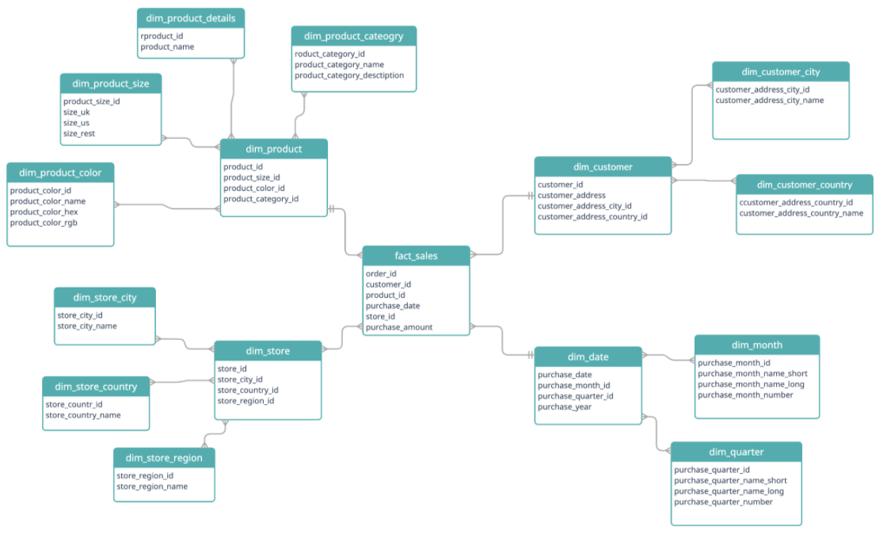
Snowflake Schema Example
Notes:
As you can see in this example of a snowflake schema, the fact table is again a Sales table, or the fact_sales. This then breaks into four dimensional tables: dim_product, dim_customer, dim_store, and dim_date. Each of these dimensional tables are connected to the fact table by foreign keys: product_id, customer_id, store_id, and purchase_date. Unlike the star schema, the dimensional tables are normalized. This means that each of the dimension tables are then broken down further into smaller dimensional tables. The resulting data model resembles a snowflake, hence the name.

Slide 9
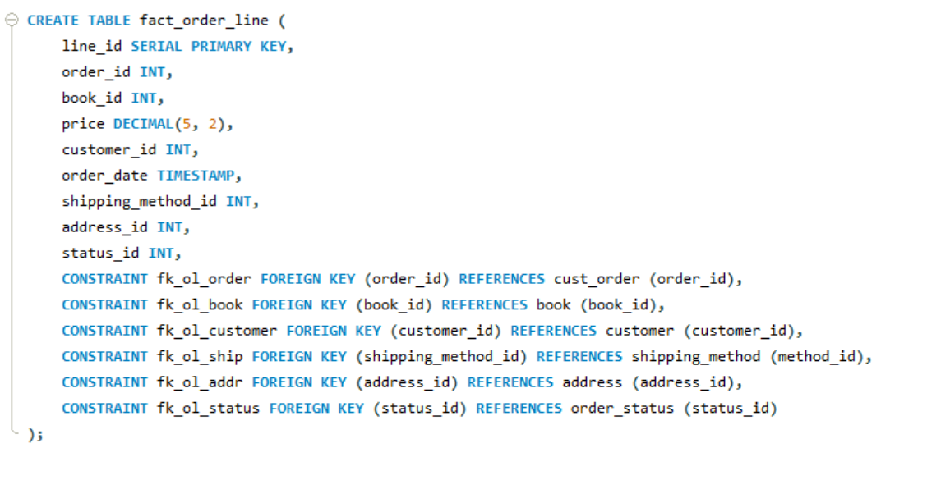
Snowflake Implementation – Fact Table
Notes:
For this project our team implemented a snowflake schema for a dataset of book sales for a fictional store called Gravity books. This dataset can be found using the links found in our report.
First we’ll look at the code used to generate the snowflake fact table, or the central table in the snowflake.
For this implementation, the fact table was: fact_order_line. The fact_order_line table consists of transactional information for the fictional bookstore Gravity Books. Some of the transactional information includes order_id, book_id, price, order_date, etc. Because it is a fact table, there are multiple foreign keys to connect the dimesion tables. These tier one dimensional tables are:
Cust_order – the customer orders dimensional table
Book – each of the book properties is located in this dimension table
Customer – Information for each customer is stored in this table
Shipping_method – shipping information
Address – Address information
Order_status – A simple normalized table that defines the status of orders

Slide 10
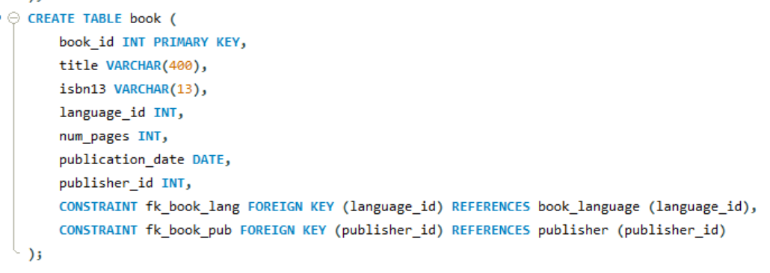
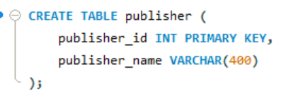
Snowflake Implementation – Dimension Tables
Notes:
Next, we have the dimensional tables. One example of a dimensional table is the Book table. This dimensional table holds information such as the book title, number of pages, publication date, etc. Because we are operating in the mindset of a snowflake schema, we’ll want to normalize this dimension table to help improve the storage efficiency. The book table is normalized by creating the deeper dimensional tables book_language and publisher. These tables are connected on the foreign keys language_id and publisher_id.
Finally, the leaf node dimension tables, book_language and publisher make our schema a snowflake.
For the entire code used to generate this schema, please see our github link.

Slide 11
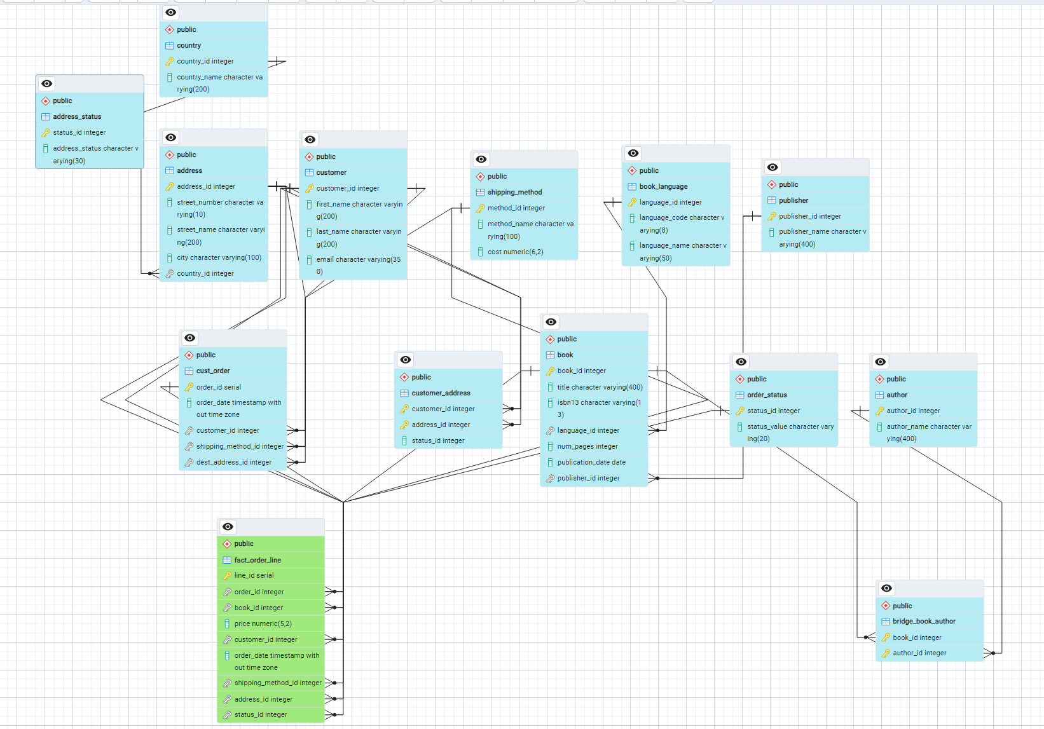
Snowflake ERD
Notes:
The final ERD diagram for this schema is a bit complicated due to the nature of a snowflake schema, but on this diagram you can see the central fact table in green connecting to each of the dimension tables, and from those dimensional tables, additional attribute tables are branching out. With that, a snowflake schema has been implemented.

Slide 12
Conclusion
Snowflake Advantages
Storage Efficiency
Consistency
Complexity
Fewer joins
Star Advantages
OLAP
Faster Queries
Lower storage efficiency
Notes:
Both star and snowflake schemas offer distinct advantages and are suited to different scenarios in data warehousing. The star schema, with its denormalized structure, excels in simplicity and query performance, making it ideal for environments where speed and ease of use are paramount. Its straightforward design facilitates rapid data retrieval and efficient execution of complex queries, making it a preferred choice for many OLAP applications. The snowflake schema’s normalized structure enhances data integrity, reduces redundancy, and optimizes storage efficiency, making it suitable for large-scale data warehouses where maintaining consistency and managing storage costs are critical. While the snowflake schema’s complexity can introduce additional maintenance overhead and potentially slower query performance due to multiple joins, its logical organization supports detailed analysis and scalability. Ultimately, the choice between a star and snowflake schema should be guided by specific project requirements, balancing the need for query performance, data integrity, and storage consideration to achieve the optimal data warehousing solution.

